Slide 1
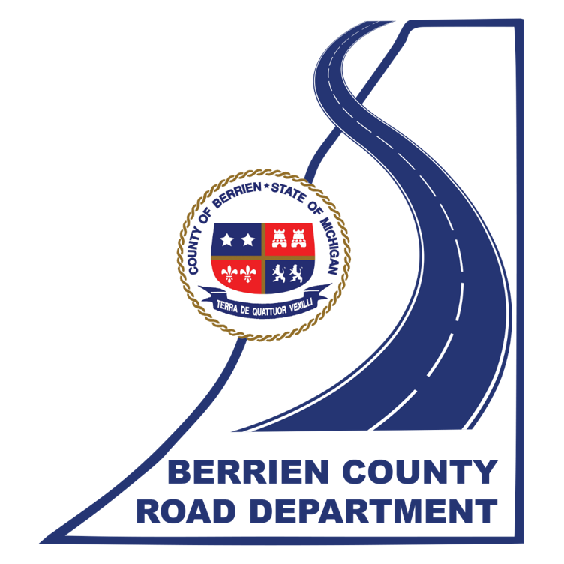
Red Arrow Gateway
Developing a Comprehensive Vision
August 19, 2021

Slide 2
Background Information
The corridor from the Indiana State Line to downtown Bridgman represents a unique gateway into southwest Michigan.
It is an important connector serving the residents of Harbor Country as well as the hundreds of thousands of people who visit this area annually, serving as an important economic driver.
There are numerous construction, engineering, and planning projects recently completed or underway that could change the approach to how this transportation corridor will be used.
The US-12 section of this corridor is being addressed through MDOT and the Marquette Greenway project. However, north of New Buffalo is in need of additional planning.
Given the number of parties with an interest in the corridor, increased policymaking and project coordination is important.

Slide 3
Entities Involved in Red Arrow Gateway
State of Michigan 3.2 miles
Berrien County 11.7 miles (Chikaming, Lake & New Buffalo Townships)
City of Bridgman 1.1 miles
Chikaming Township 6.9 miles (County Road Department Managed)
Lake Charter Township 2.3 miles (County Road Department Managed)
New Buffalo Township 2.5 miles (County Road Department Managed)
City of New Buffalo 1.4 miles
Village of Grand Beach 0.3 miles

Slide 4
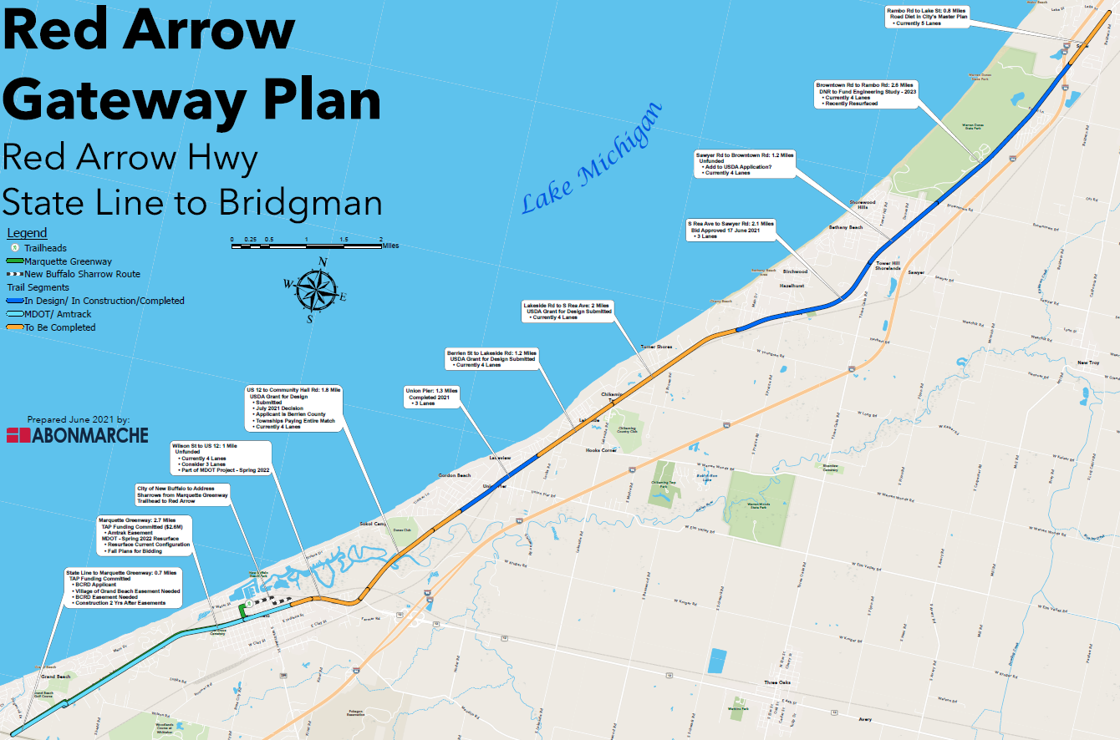

Slide 5
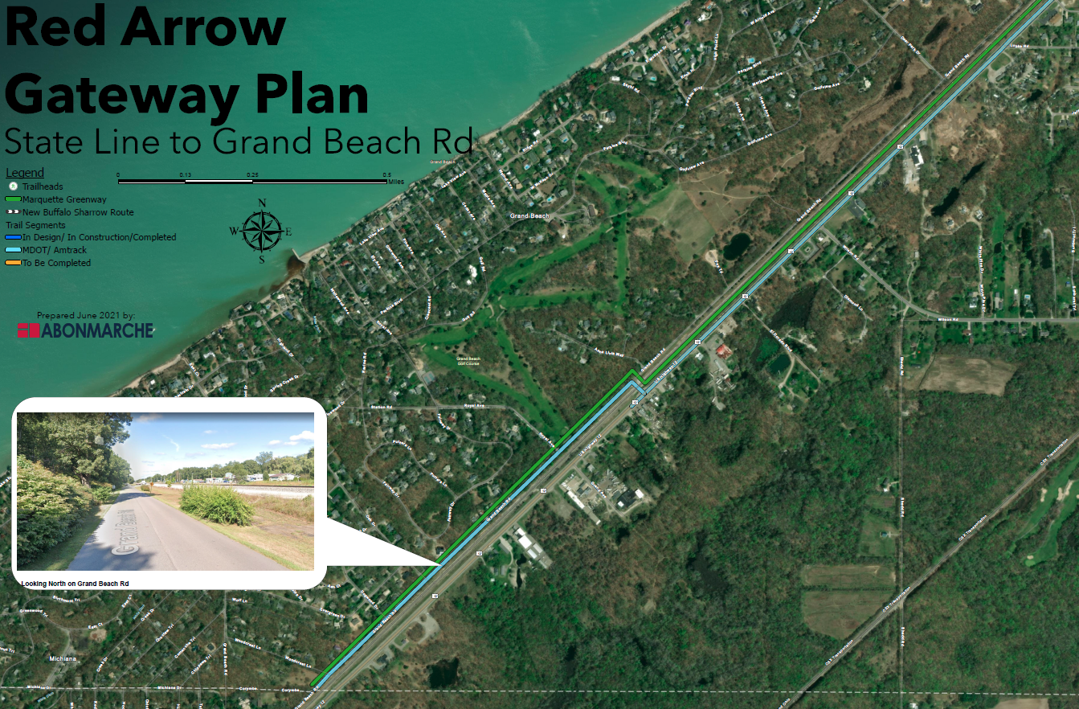

Slide 6
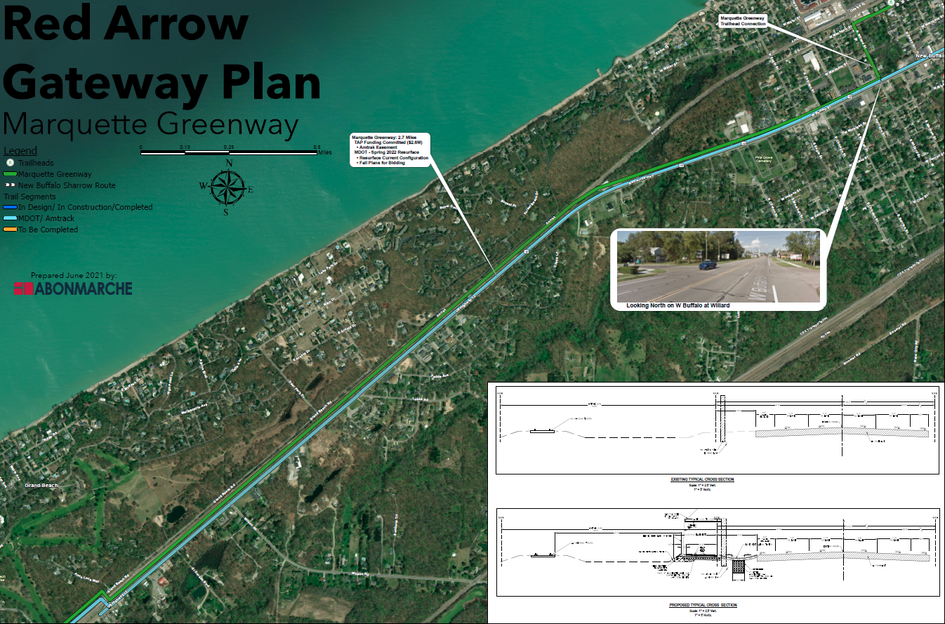

Slide 7
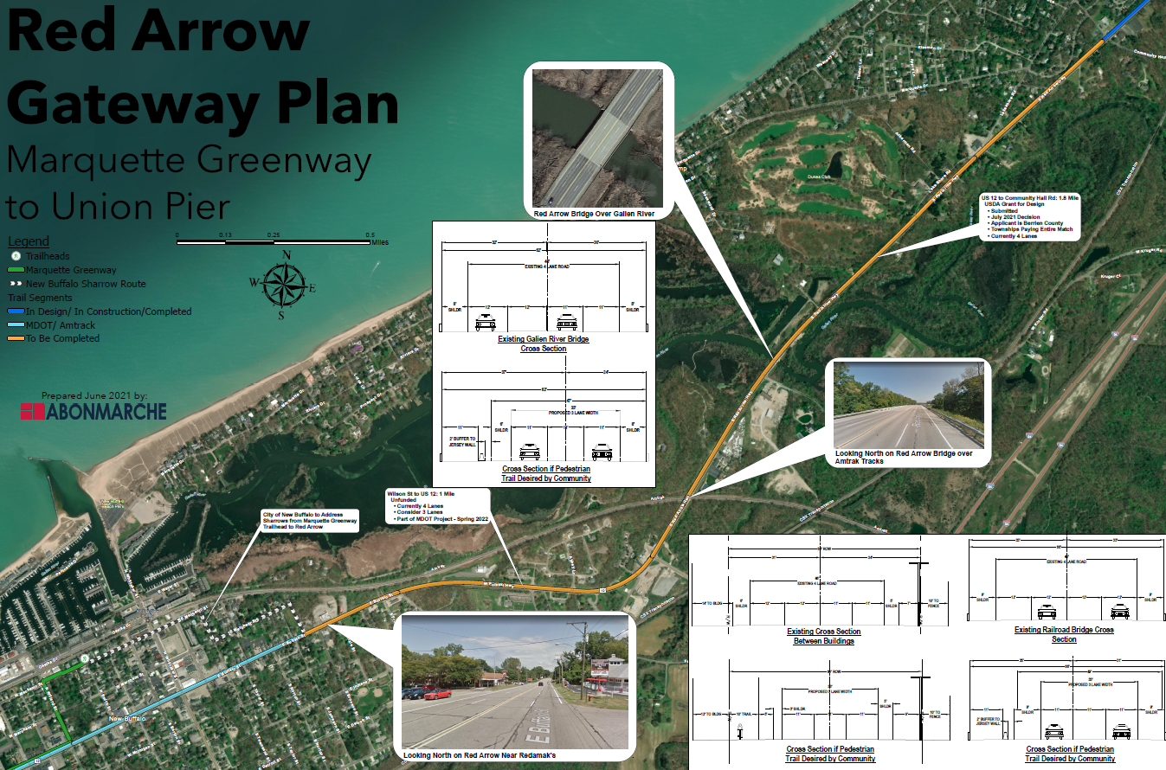

Slide 8
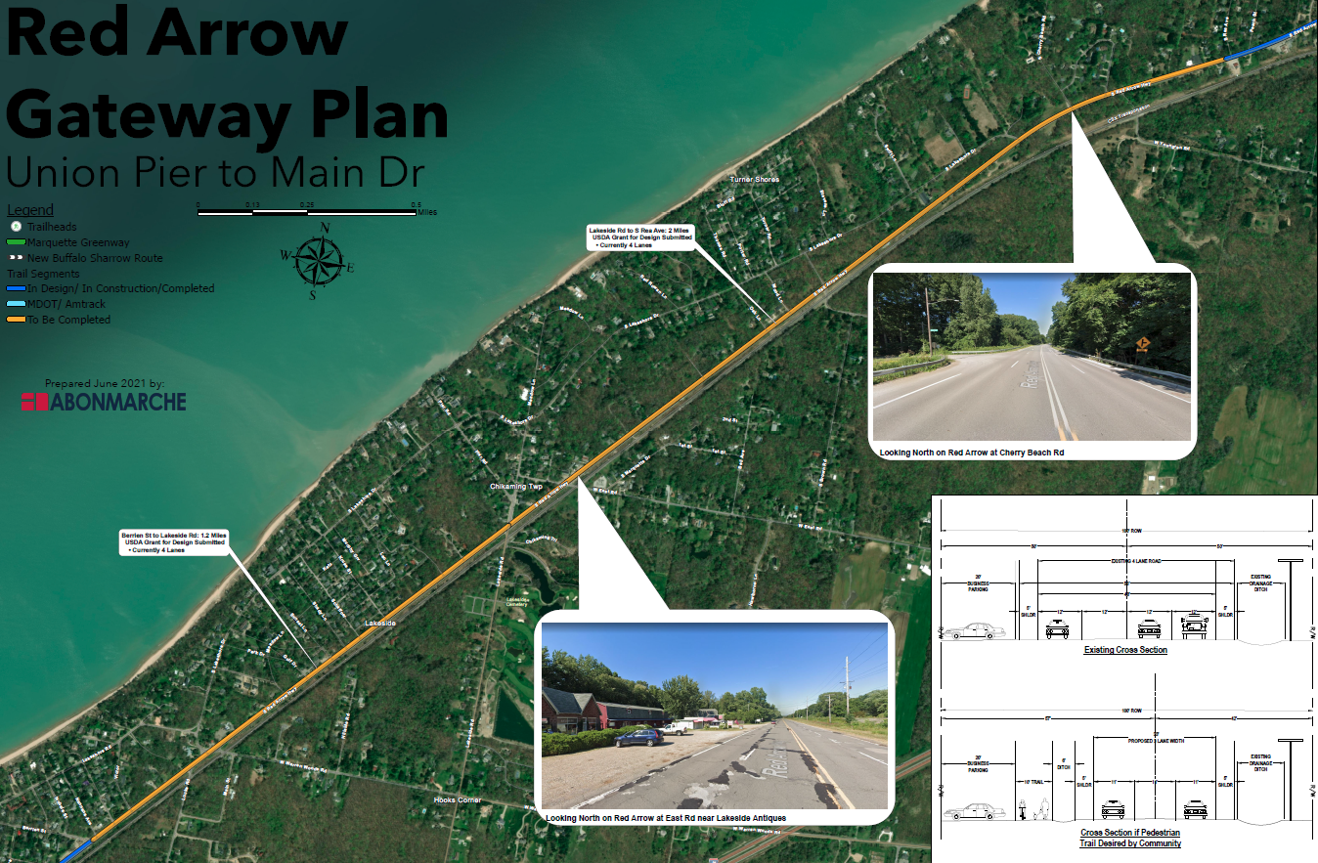

Slide 9
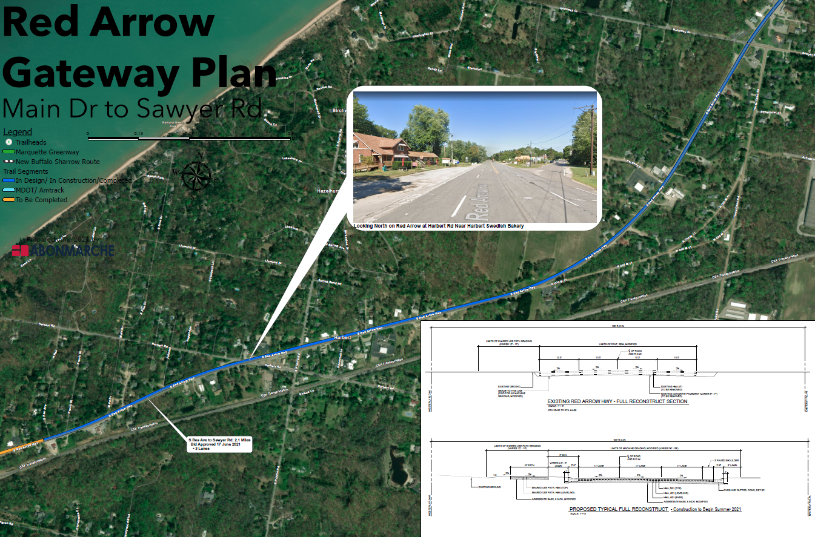
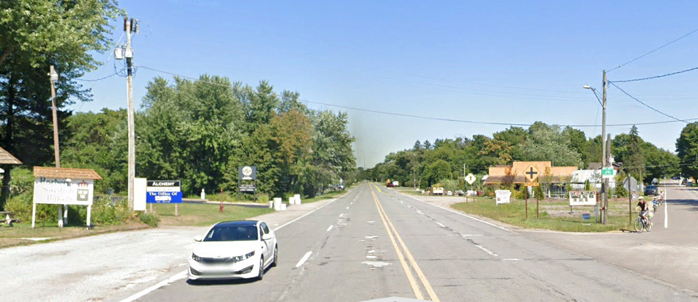

Slide 11
Community Dialogue
During June and July of 2021, two meetings were held with representatives of several groups working on projects in the Red Arrow Corridor to discuss planned projects and long-range policy goals. The following entities were involved in the meetings:
While formal votes of these entities have not been taken, a significant majority of those in attendance were in favor of completing the remainder of the corridor in the same manner as recent and planned projects by incorporating a non-motorized trail and road diet. The proposed trail is also included in the Berrien County 2020-2024 Parks and Recreation Plan.
Berrien County Board of Commissioners | Berrien County Road Department
City of Bridgman | Chikaming Township
Lake Charter Township | New Buffalo Township
Southwest Michigan Planning Commission | Abonmarche

Slide 12
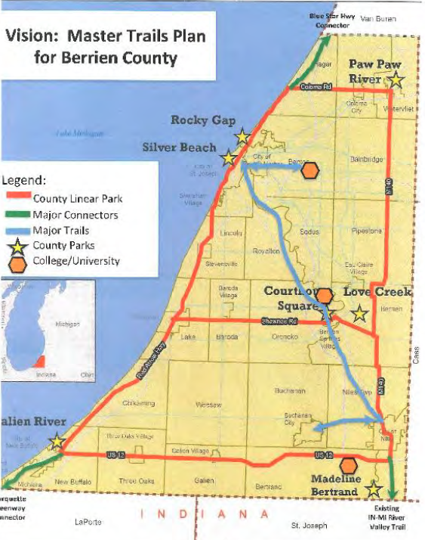
Economic & Social Benefits of Trails
Map from Berrien County
2020-2024
Parks and Recreation Plan
Trails connect communities, residents, visitors and businesses
Trails provide a family-friendly recreational venue that builds a sense of community
The availability of trails has been shown to increase overall community health through increased activity and decreased carbon omissions

Slide 13
Safety Benefits of Road Diets
Studies indicate a 19%-47% reduction in overall crashes
Reduces operating speed
Eliminates speed differential through more consistent traffic flow
Eliminates weaving in and out of traffic lanes at high speeds
Side street traffic can more comfortably enter Red Arrow because there are fewer lanes to cross

Slide 14
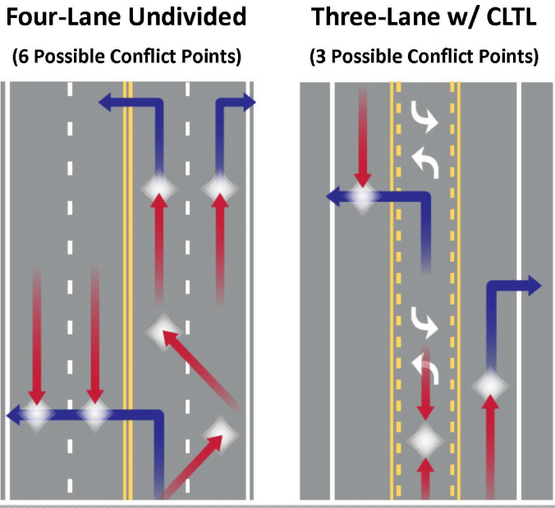
Safety Benefits of Road Diets
Four-lane undivided
Inside lane is shared by higher speed through traffic and left turning traffic
Road Diet
Reduces conflict points that contribute to rear-end, left-turn, and sideswipe crashes

Slide 15
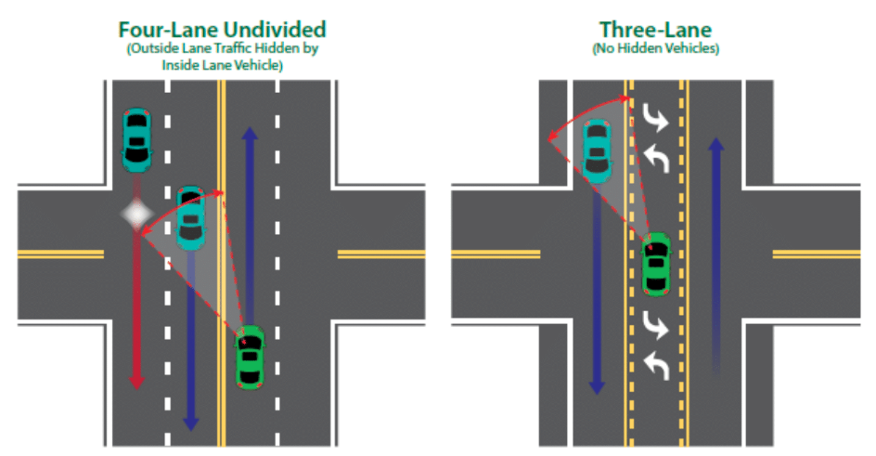
Safety Benefits of Road Diets
Improved site lines

Slide 16
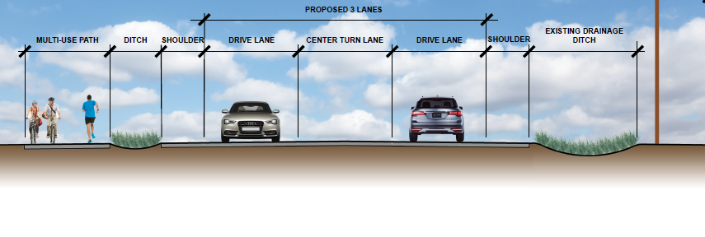
Safety Benefits of Trails
The road diet being constructed or planned creates a significantly larger barrier between traffic traveling 55+ mph and the pedestrians and cyclists within the Red Arrow Corridor. Implementing the strategy through the remaining areas of the corridor will have numerous community benefits as well as safety benefits for motorists and pedestrians alike.

Slide 17
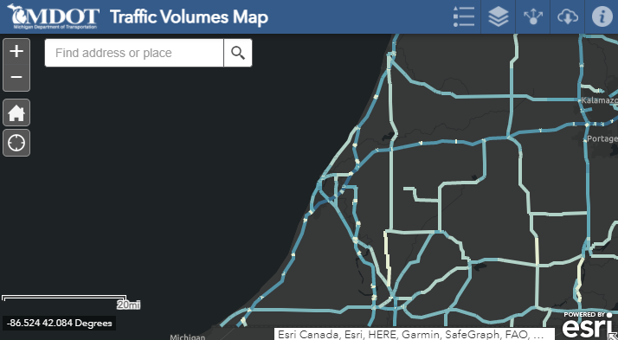
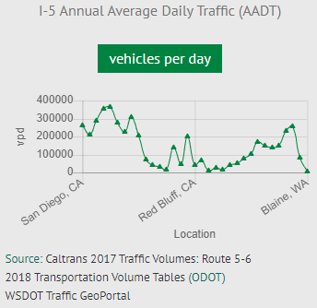
Capacity Concerns of Road Diet
When combining I-94 and Red Arrow Highway, there are10 lanes of roadways carrying travelers into, around, and through Berrien County. I-94 and Red Arrow Highway combined carry an average daily traffic count of less than 75,000 cars per day in the summer months, and even less the rest of the year.
Interstate 5 in California at its widest is12 lanes and carries 400,000 cars per day. The Dan Ryan in Chicago is16 lanes and carries 300,000 vehicles per day.

Slide 18
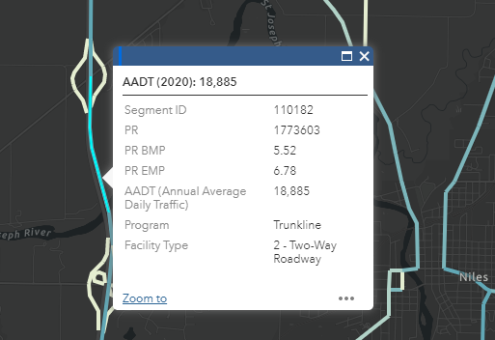
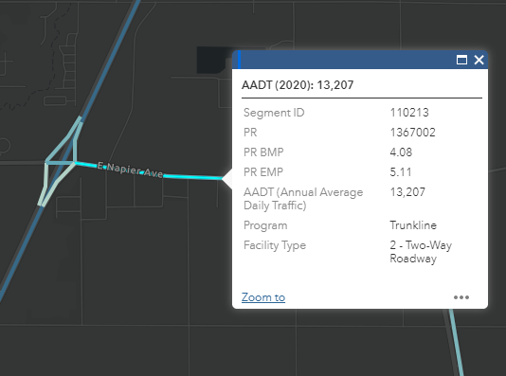
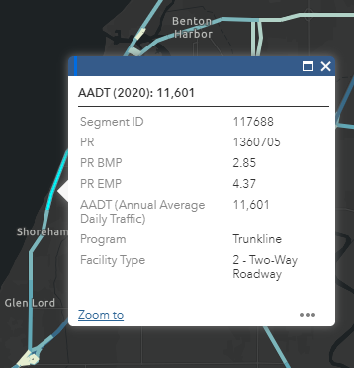
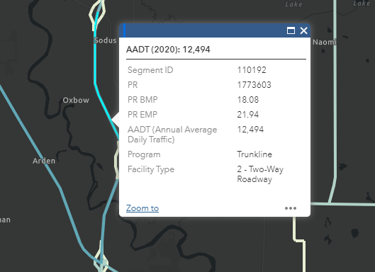
Capacity Concerns of Road Diet (other major roads in Berrien County)

Slide 19
Capacity Concerns of Road Diet
I-94 incidents with emergency closures (Bridgman to New Buffalo)
Total Closures
2018 – 1 eastbound, 1 westbound
2015-2017 – 1 eastbound, 1 westbound
Double Lane Closures
2018 – 3 eastbound, 1 westbound
2015-2017 – 3 eastbound, 3 westbound

Slide 20
Capacity Concerns of Road Diet
I-94 incidents with emergency closures (Bridgman to New Buffalo)
11 closures during snowy/icy conditions
2 closures in summer
No closures in both directions at the same time
Closure times
Average: 2 hr 47 min
Shortest: 20 min
Longest: 16 hr 18 min
Averages to 5 hours per year

Slide 21
Funding Opportunities
Berrien County was recently awarded a grant of $99,000 from the U.S. Department of Agriculture to be matched by funding from New Buffalo and Chikaming Townships to fund the design of the trail from New Buffalo to Sawyer.
Several other funding sources exist which can be pursued to fund additional planning and construction needs, including:
County Act 51 (percentage required to be used for non-motorized activities)
MDOT Transportation Alternatives Program funding
Michigan Department of Natural Resources
American Rescue Plan Funding
Infrastructure bill currently being considered in Congress
Foundations and other private sources
Local commitments from the communities along the Red Arrow Corridor
All the funding for the trail does not need to be in place up-front. A capital stack can be developed allowing the trail to be built as long as work on Red Arrow Highway is not undertaken inhibiting that possibility.

Slide 22
Questions & Discussion

